Slide 1
Fake News! Determining Bias in Media The Results

Slide 2

Inconclusive!
Liberal, Neutral or Conservative?
Notes:
Our results overall were inconclusive. We were not able to “prove” bias using the models we selected. So let’s take a look at why we came up with that result.

Slide 3
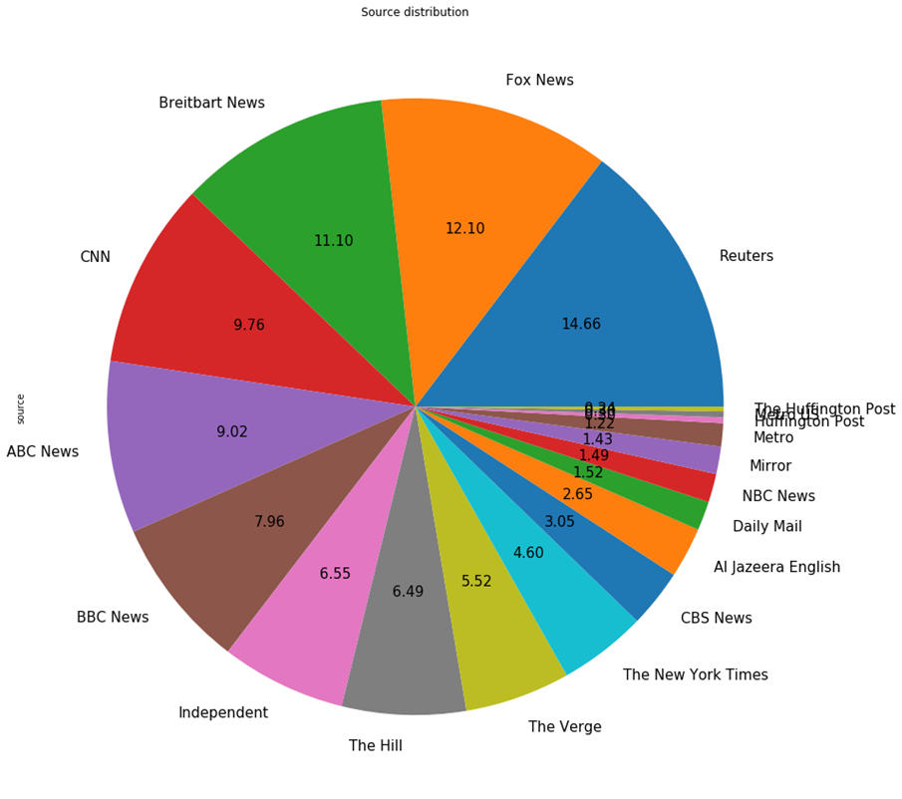
Is the distribution of sources even in our data set?
Distribution could be better – it ranges from 1.56% from Huffington Post to 14.66% for Reuters
Notes:
For the most part our distribution is pretty good – but it could be better. We utilized the Kaggle Dataset originally presented, but also added on additional news headlines and summaries manually collected directly from the source websites

Slide 4
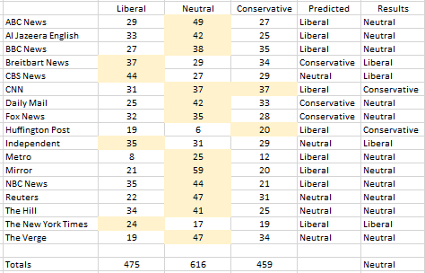
AMT Workers were not able to accurately predict the appropriate Source Label of: Conservative, Neutral or Liberal
Notes:
We had budgetary constrictions and could not run all 3,000+ headlines and summaries through Amazon Mechanical Turk – so we took a random sampling of 20 from each source. It turns out the AMT workers were way off in their labeling compared to our predictions. One thing we did not consider is that each worker would have their own bias to overcome in order to provide true results.

Slide 5
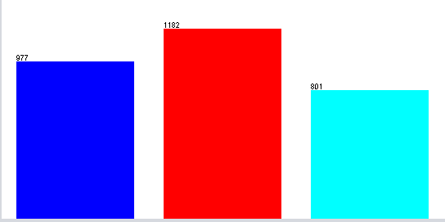

WEKA
Liberal
Neutral
Conservative
J48 Pruned Tree
Naïve Bayes
Stratified Cross Validation
99.865 % Incorrect Classification
99.865 % Incorrect Classification
99.898% Incorrect Classification
Notes:
So we next ran the full data set to see if we get accurate labels this way – and again the tests came back inconclusive. The computer could not label the news summaries accurately – we had a 99% Incorrect classification on all three types of tests.

Slide 6
If we are not able to determine political bias using modeling, can we determine sentiment?
YES! And it is all NEGATIVE!

Slide 7
From all data sources Sentiment Analysis came back negative – ranging from -1 to -5
7
Notes:
Running the full data set using SentStrength we were able to see that all our news summaries skewed in the negative range. (You can better see here too that the data was not as balanced as it should be).

Slide 8
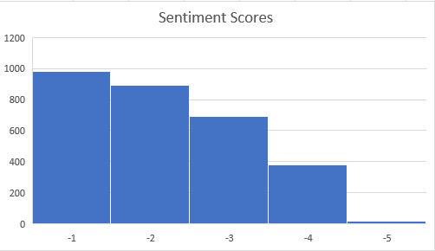
Scores Across All Sources
Notes:
Here you can see the majority of summaries skewed -1 and -2 … so could be considered closer to neutral in sentiment.

Slide 9
What about Topics?
Can they predict bias?
Notes:
Then we decided to test out Topic Modeling. Could we determine bias or sentiment based on the topics that come up?

Slide 10
The Topic Modeling results
Topic 0
Topic 1
Topic 2
Topic 3
Topic 4
iran
plane
new
video
crash
americans
just
japan
congress
boeing
iran
trump
soleimani
says
strike
2020
impeachment
democrats
pelosi
biden
iraq
live
general
new
australia
Notes:
Here are the top 5 topics from the full dataset ran 5 times. You can tell the summaries are focused on a plane crash, the Presidential Impeachment, the Democratic Debates, Iran and Iraq conflicts, and just a touch on the Australian fires. But you can’t really determine bias or sentiment based solely on the topics.

Slide 11
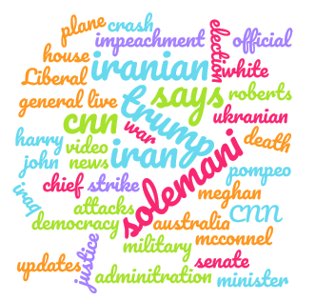


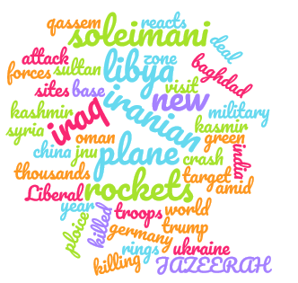
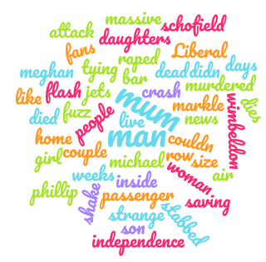





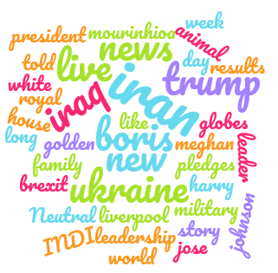




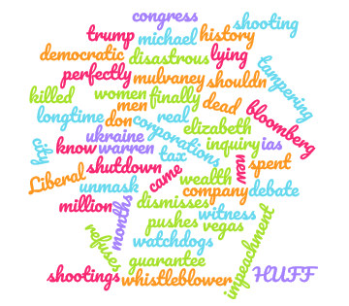

Source Topic Word Clouds
Notes:
Here are the individual news source top topics in Word Cloud Form. When we look at the strongest topic in each – we see the similar results: Trump, Impeachment, Democrats, Iraq, Iran, etc … BUT – when you look at a few of the word clouds you can see some differences. For example – The Verge is considered a neutral source – their main topics were Samsung, Tech and Concept (talking more about the new S20 coming out). CBS word cloud is much more balanced in topics with nothing notable standing out. And Brietebart has words like Attack and War that stand out. (a more conservative source)

Slide 12
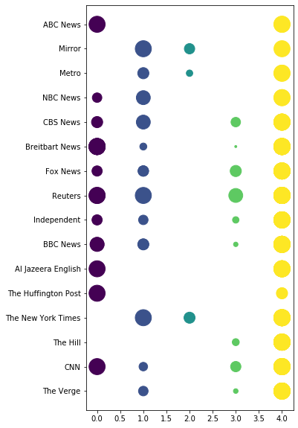
Clustering
What does this tell us?
Notes:
Clustering based on a bigram and trigram of the content shows that all of the news sources had the same core information and there were some groups that formed but the majority of the news sources were in multiple clusters. However, cluster 2 includes only three news sources, Mirror, Metro, and The New York Times. These three are all newspapers, but what is interesting is that the Mirror and Metro are both based in the United Kingdom, while The New York Times is located in the United States.

Slide 13
So what’s the conclusion?
Topic Modeling may help indicate bias – but more testing is needed
The majority of news stories are negative
Crowd Sourcing can not be used for classification as personal bias has to be ruled out.
Clustering indicates that the primary type of delivery may need to be considered when comparing the sources.

Slide 14
Thanks!
Does anyone have any questions?

